Slide 1
Més que un team

Slide 2

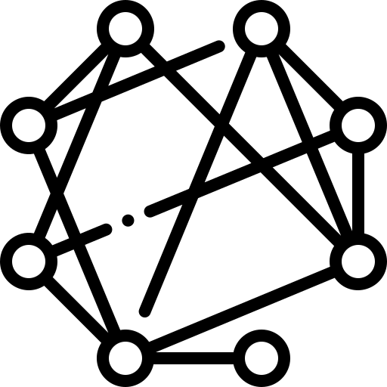




EXPLORATORY
DATA ANALYSIS
AGENDA
FRAUD DETECTION
DATA ANALYSIS: CONNECTIVITY
PROFILE SCORING
HR: Dashboard
MODEL PIPELINE & SUMMARY

Slide 3




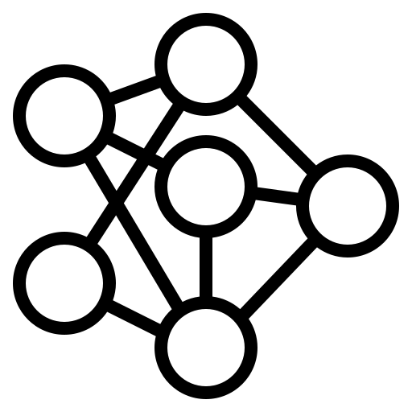
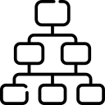

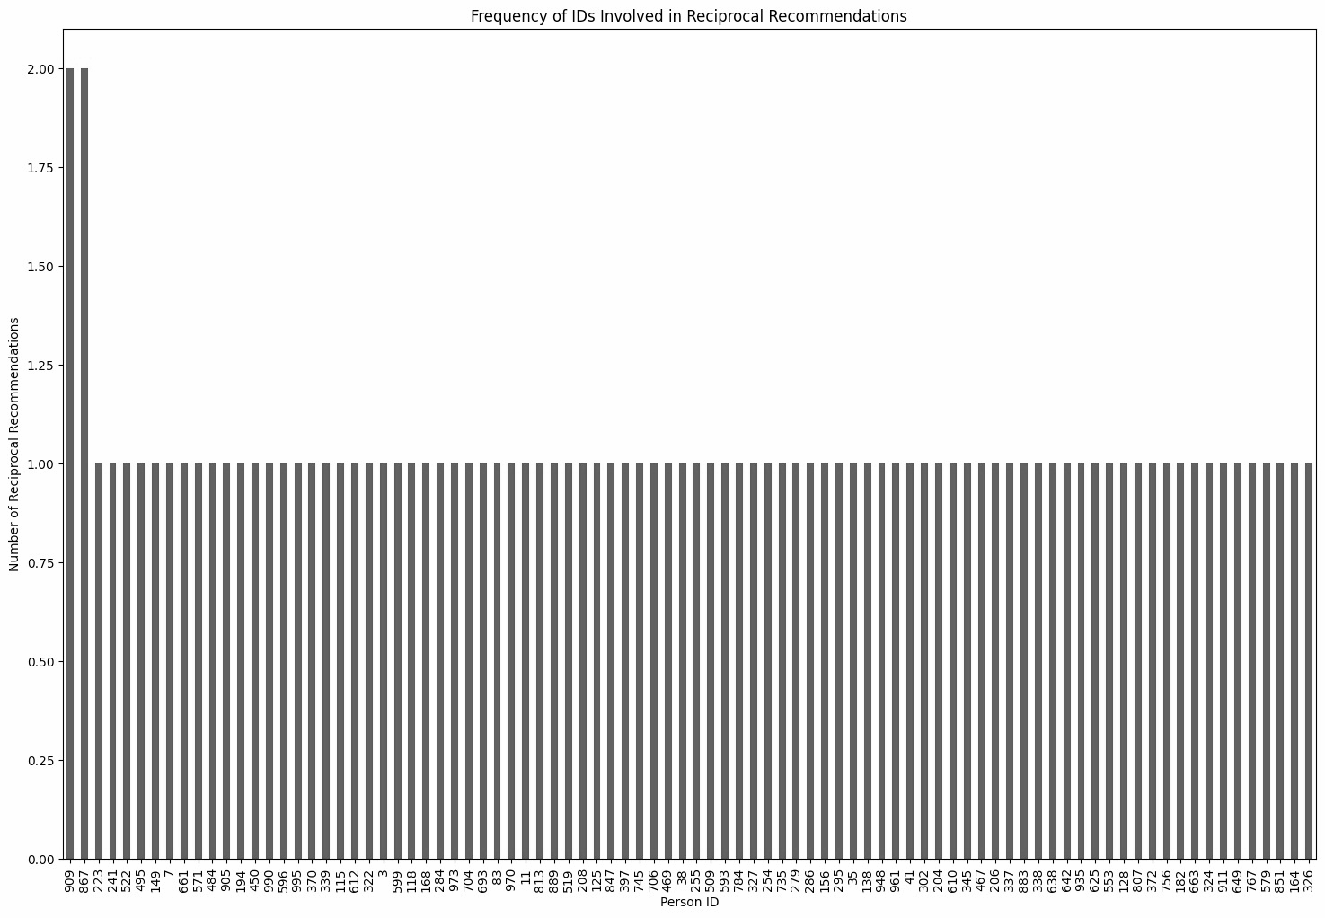
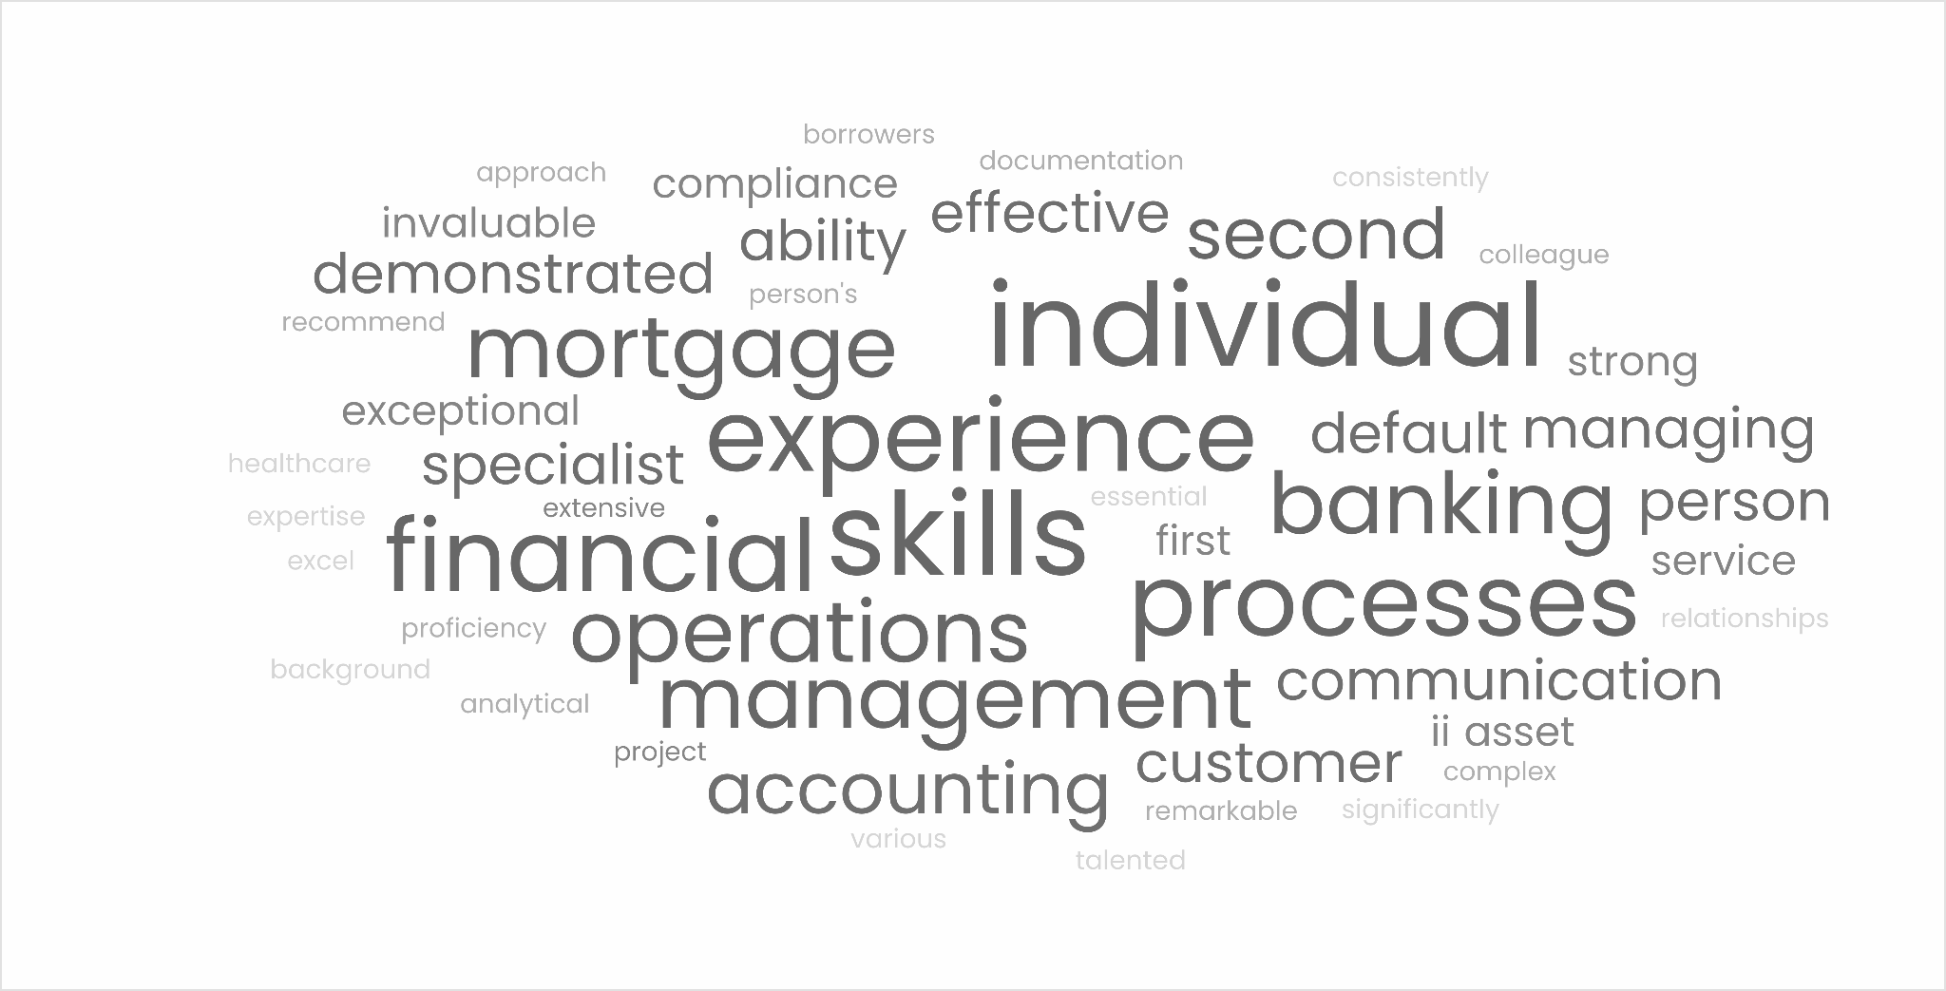
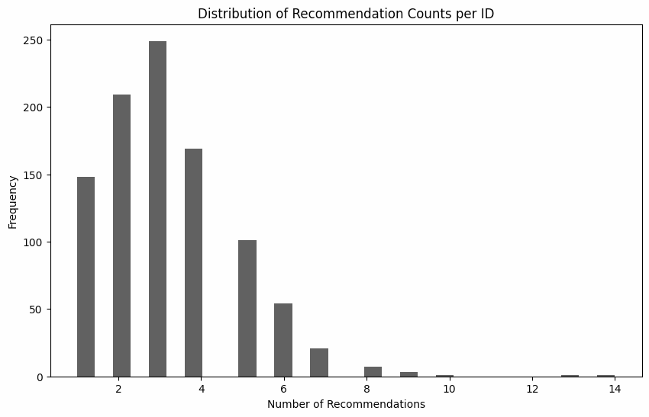
EXPLORATORY DATA ANALYSIS
EXPLORATORY
DATA ANALYSIS
Fraudulent Score
Connectivity
Score
Profile
Score
EDA
Fraudulent Score
Connectivity Score
Profile Score
Satya’s Analysis
HR: Decision Support Dashboard
Bar Graph and Word Clouds
Other Insights
Count | 964/1000
Mean | 3.2
min | 1.0
Max | 14.0
Frequency of reciprocal recomme- ndation, IDs without reciprocal recommendations are excluded.
The word cloud shows the most common tags in the letter of recommendation for IDs 1 & 2 having 6 texts.

Slide 4
Fraud Detection:
Fraudulent Score
EXPLORATORY
DATA ANALYSIS
Fraudulent Score
Connectivity
Score
Profile
Score
Large Language Models and other architectures were utilized to identify potential exaggerations in Letters of Recommendation (LORs) by analyzing language patterns indicating inflated claims. Suspicious LORs were flagged, and instances of reciprocal recommendations were identified and marked in binary format. LORs were also compared to resumes to detect inconsistencies, aiding in flagging potential fraud.
Cycles in LOR
Exaggerated LOR
Correlation with CV
Cycles in LOR
Exaggerated LOR
Correlation with CV
Identified IDs in reciprocal cycles.
Flagged as 1 (engaged) or 0 (not engaged).
To be weighted and used in a statistical model.
DistilBERT creates semantic embeddings for LOR lines.
Vectors are compared and clustered using KNN.
Outliers indicate exaggeration; distances provide ratios and scores.
Created embeddings for CV and LOR.
Calculated normalized cosine similarity between them.
High similarity indicates alignment; low suggests potential fraud.

Slide 5
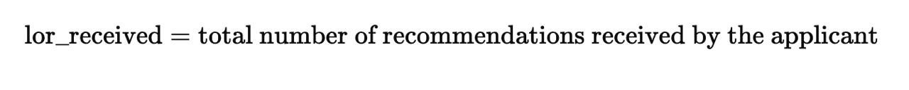
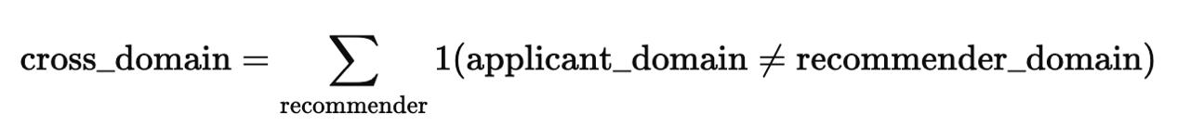
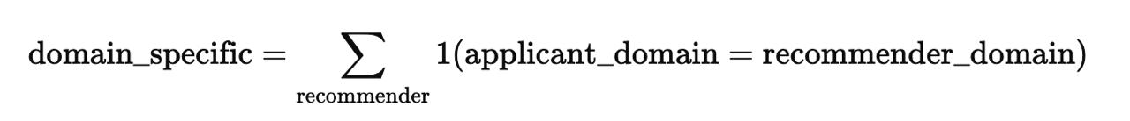
Data Analysis:
Connectivity
EXPLORATORY
DATA ANALYSIS
PRE-
PROCESSING
Fraudulent Score
Connectivity
Score
Profile
Score
The number of genuine LORs received and given by a person helps determine their connections.
01
Letter of Recommendations
Qwen2 LLM was used to extract resume details and quantify connections based on overlapping experience or education
02
Work Experience and Education
03
Influence Score
Domain Influence Ratio
Degree Centrality
Domain-
specific In-degree
Cross Domain In degree
Final Influence Score
A weighted composite measure that integrates domain-specific and cross-domain connectivity.

Slide 6
Profile Score
EXPLORATORY
DATA ANALYSIS
PRE-
PROCESSING
Fraudulent Score
Connectivity
Score
Profile
Score
Profile Score calculation
Work Experience Evaluation
Skills Assessment
Metric Importance: Profile Score is used to determine the quality of a candidate's profile.
Work Experience Quantification: Work experience is quantified as a key factor in evaluating a candidate's contributions.
Model Used: LLM Model Qwen2 identifies the number of years of work experience for IDs 0 to 999.
Normalization: The dataset is normalized to derive a Profile Score.
Score Interpretation: Higher scores indicate greater work experience
Skills Importance: Profile quality also depends on individual skills.
Keyword Search Functionality: Implemented in the HR Dashboard to filter resumes based on specific job-related keywords.

Slide 7
HR SUPPORT DASHBOARD FEATURES
Feature 01
Keyword Searching with profiles comparison of any number of IDs of your choice
Feature 02
Fraudulent Score calculation and display
Feature 03
Connectivity/Influence Score
Feature 04
Profile Score and Segregation based on Domains
Feature 05
Zipped CV and LORs received for a given ID

Slide 8
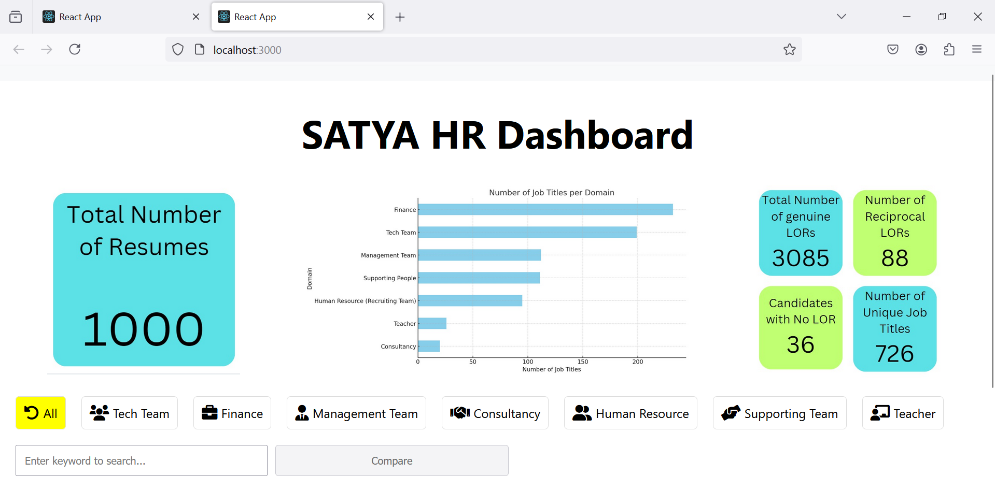
HR SUPPORT DASHBOARD

Slide 9
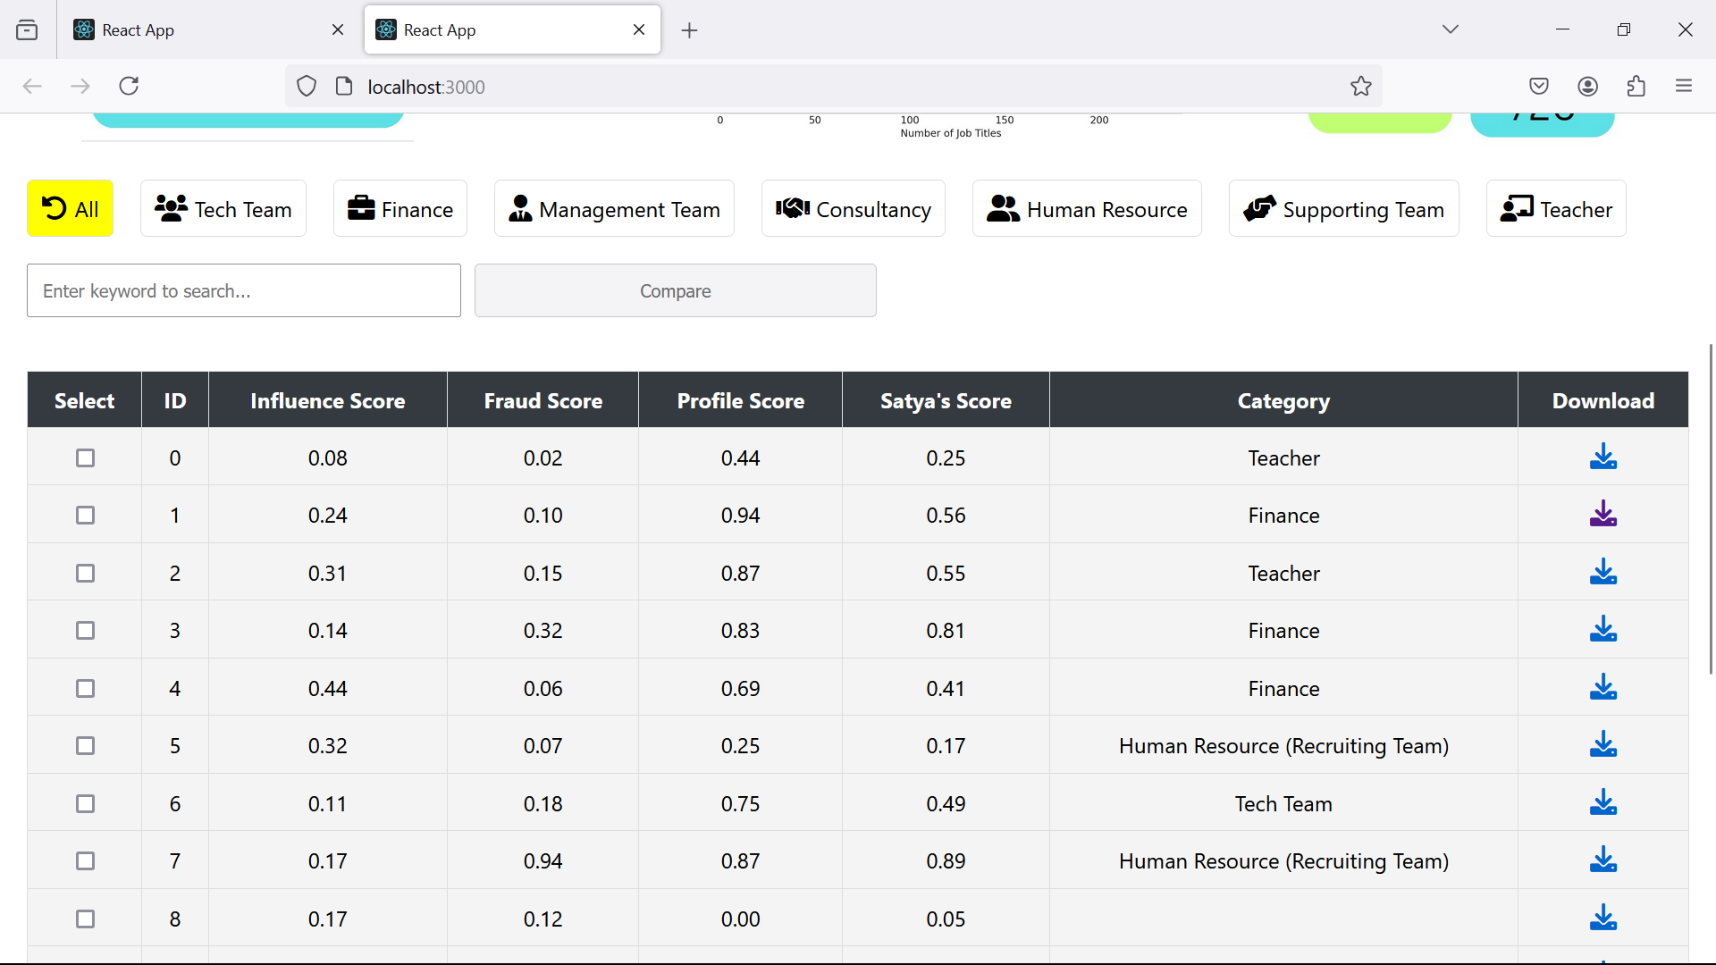
HR SUPPORT DASHBOARD

Slide 10
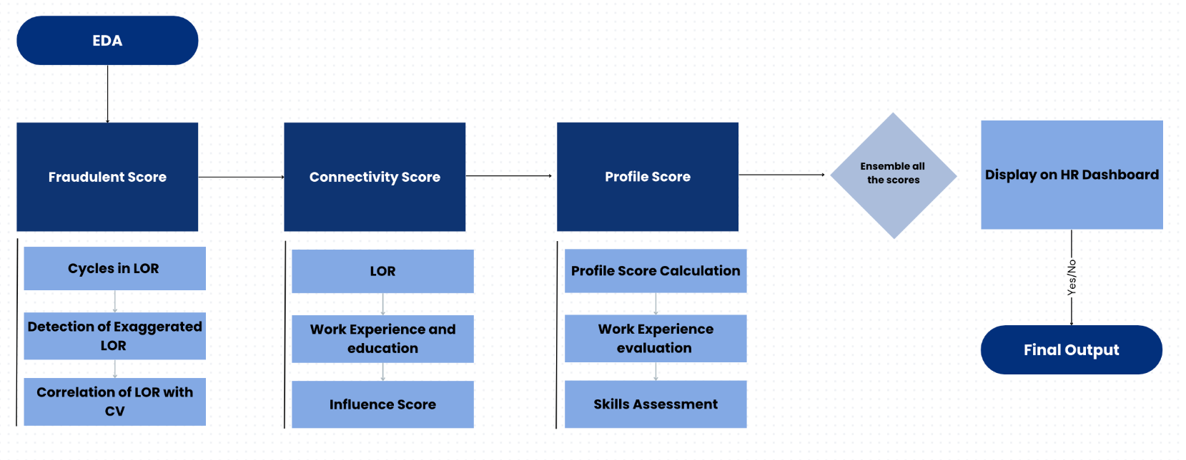
SUMMARY AND MODEL PIPELINE
“The HR decision-making environment utilizes NLP, advanced LLMs and statistical models to evaluate resumes and recommendation letters, generating Fraudulent, Connectivity, and Profile Scores to help recruiters efficiently identify and assess candidates.”

Slide 11
THANK YOU!

Slide 12
ANNEXURE

Slide 13

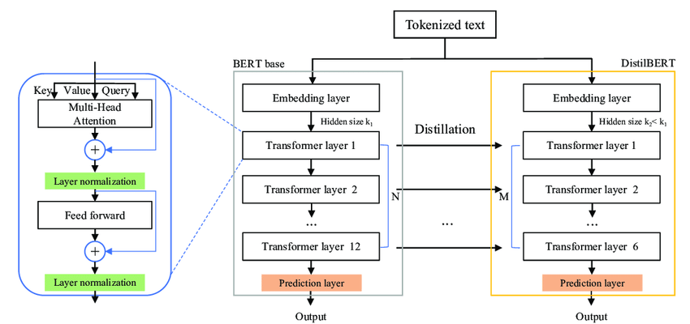
DistilBERT
DistilBERT is a smaller, faster version of the BERT language model, designed to maintain high performance while being more computationally efficient. It achieves this through knowledge distillation, where a smaller model earns to mimic the behavior of a larger model while using fewer parameters and resources.
Nuanced Detection: DistilBERT captures semantic meanings to identify exaggerations in Letters of Recommendation.
Anomaly Identification: It detects outliers and unusual patterns, flagging potential fraud.
Why DistilBERT?

Slide 14
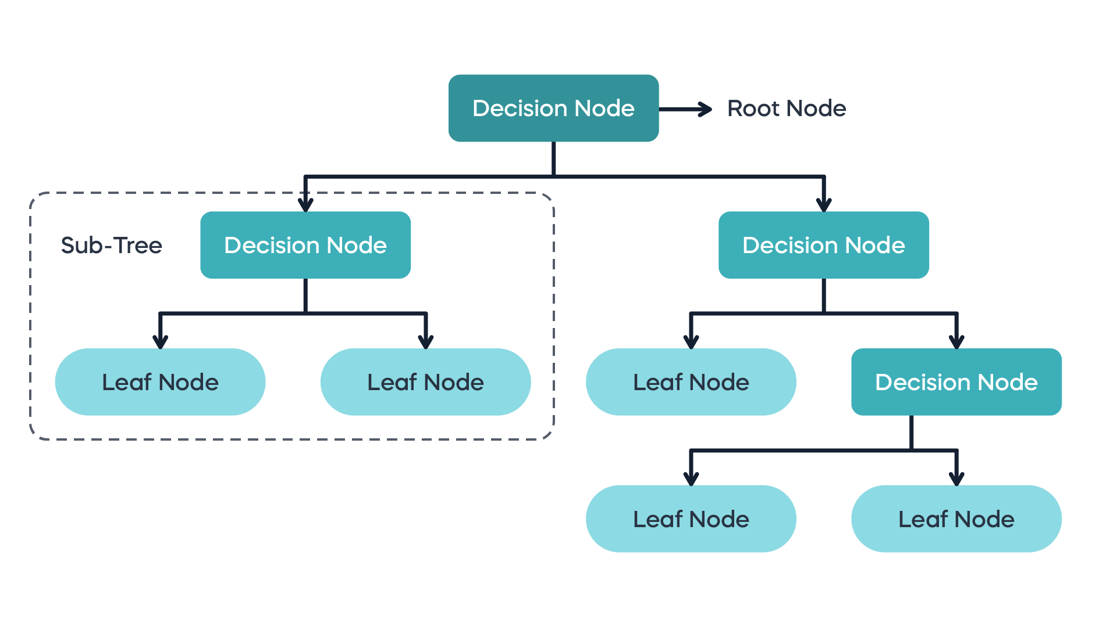
Decision Trees
Non-linear Relationships: Decision trees manage complex, non-linear feature interactions for optimal outcomes.
Feature Importance: They rank feature significance based on split usage and impurity reduction.
Missing Data Handling: Decision trees function well with missing data, focusing on stable variables.
Outlier Resilience: They remain effective despite outliers or extreme values.

Slide 15
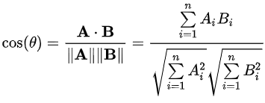
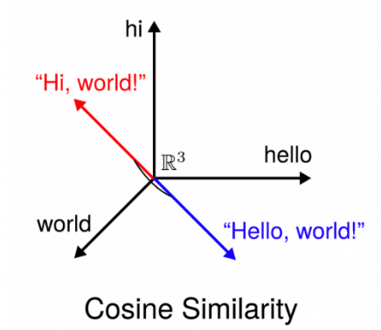
Cosine Similarity
We calculated the cosine similarity of the LORs received by an ID and the CV of the ID to quantify whether the LORs align with the CV or not.
if (cosine similarity > threshold) → classify as 1{CV maps correctly with the LOR}
if (cosine similarity < threshold) → classify as 0 {LOR is either generic or different from the applied Job Title}

Slide 16
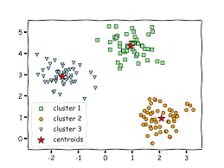
KNN CLUSTERING
K-Nearest Neighbors (KNN) clustering is a method used to classify sentences into clusters based on their similarity. Instead of creating centroids like in K-means, KNN classifies a point based on its distance to its ‘K’ nearest neighbors. The similarity is determined by calculating the distance (typically Euclidean) between sentences in a high-dimensional space. Each sentence is assigned to the most common cluster among its nearest neighbors. The value of 'K' determines the number of neighbors used to decide the cluster for a particular point.

